Slide 1
Opportunities for Vegan Restaurants in Toronto
Liam Chalcroft

Slide 2
Locating target demographic is vital
It is important for restaurants to open in an area that is already popular with their target demographic
Predicting the best location for a restaurant to open a new vegan chain depends on finding the areas popular with their demographic
Can then compare locations in terms of costs and appeal to target customer

Slide 3
Data acquisition
Postal codes obtained from Wikipedia dataset (https://en.wikipedia.org/wiki/List\_of\_postal\_codes\_of\_Canada:\_M)
Geo-data for clusters obtained from Cognitive Class (https://cocl.us/Geospatial\_data)
Housing prices obtained from Open Toronto Initiative (https://open.toronto.ca/dataset/wellbeing-toronto-housing/)
Chloropleth geo-data obtained from Open Toronto Initiative (https://open.toronto.ca/dataset/neighbourhoods/)

Slide 4
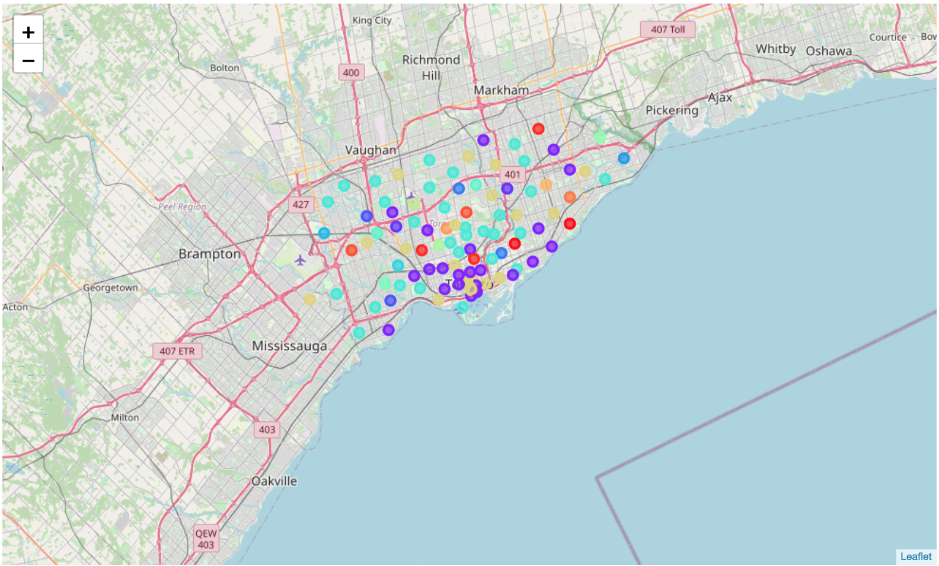
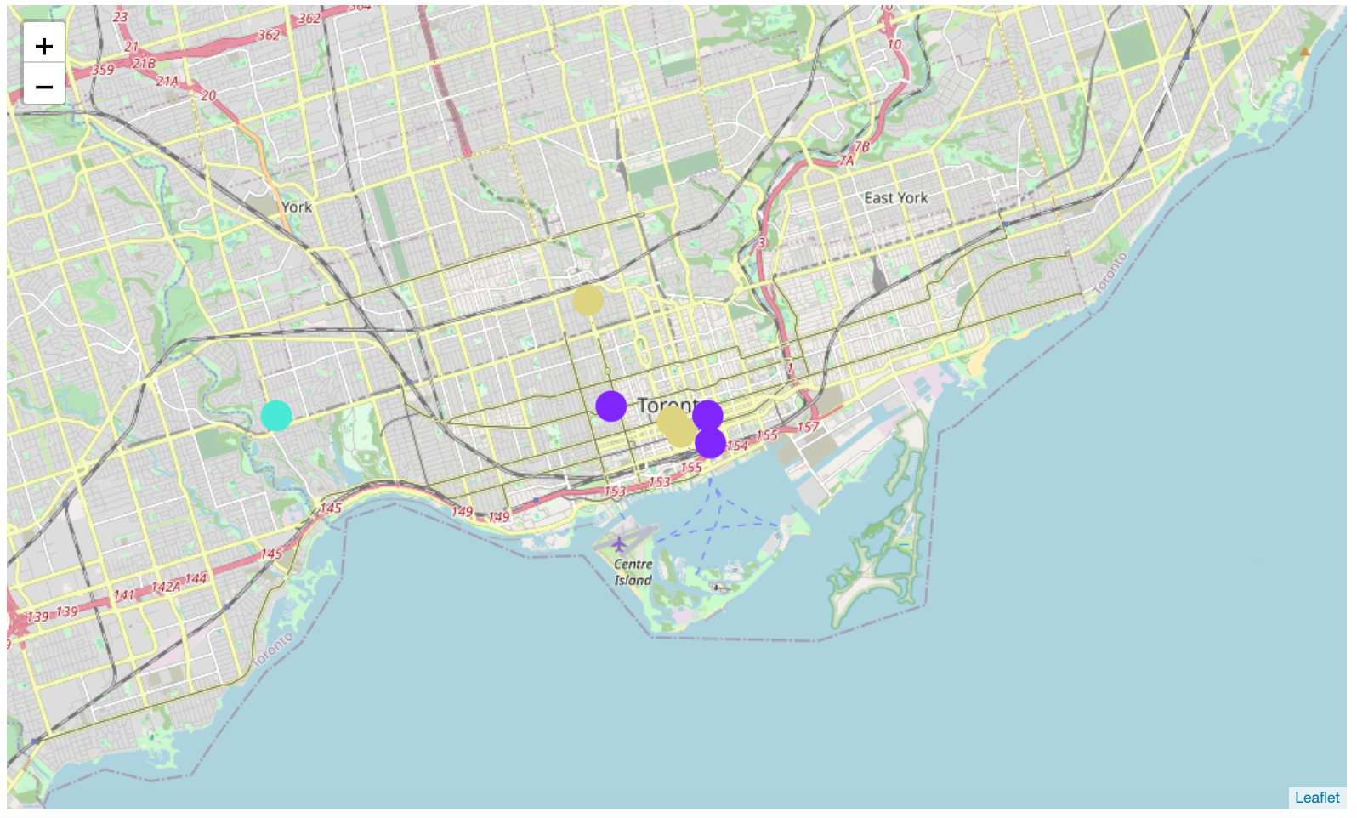
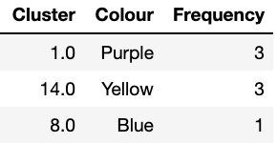
Vegan restaurants located in 3 clusters
K-means clustering (k=20)

Slide 5
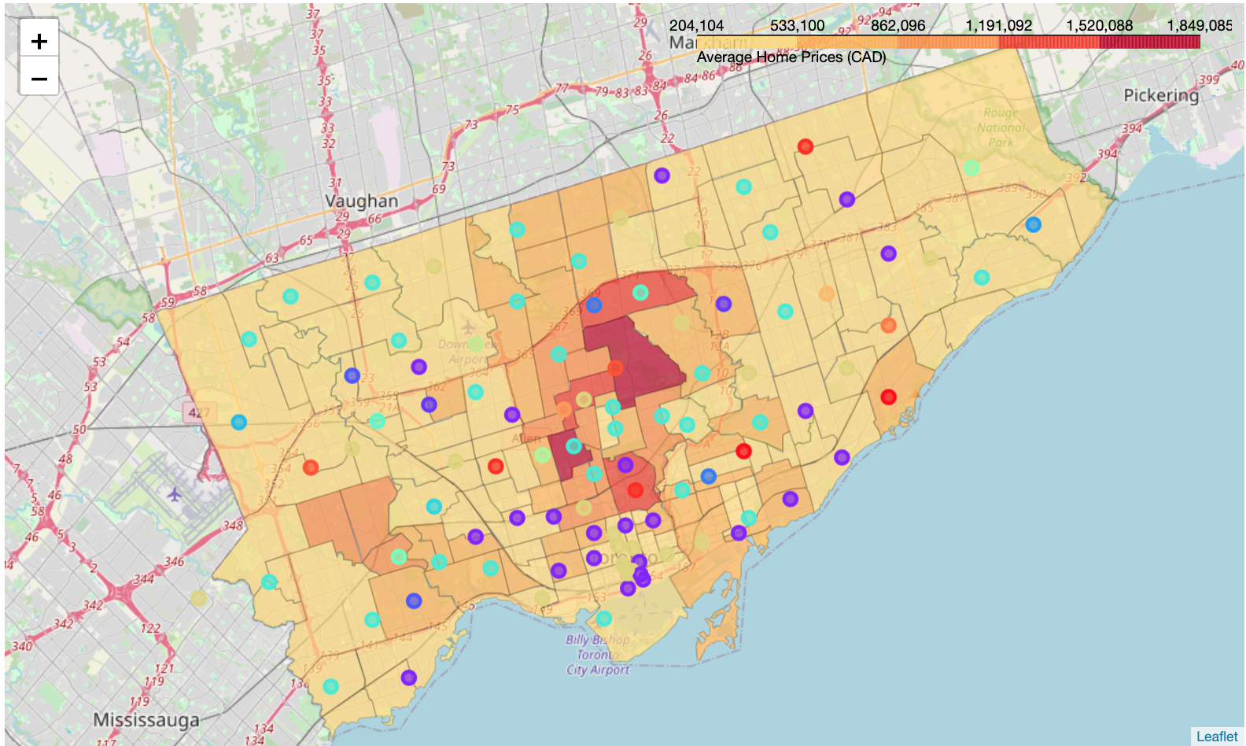
Property prices cheapest in purple cluster
Creates list of potential target locations:
M8V
M6H
M3M
M1L
M1N
M1H
M1S
M5J
M5E
M4Y

